Slide 2
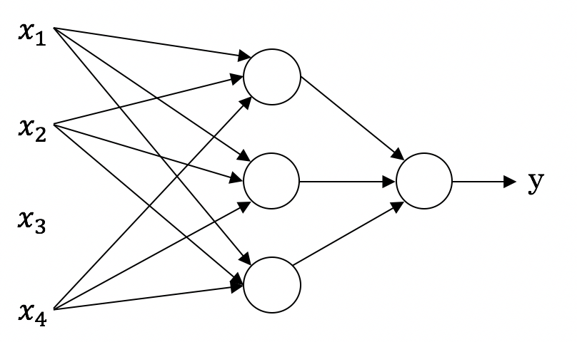
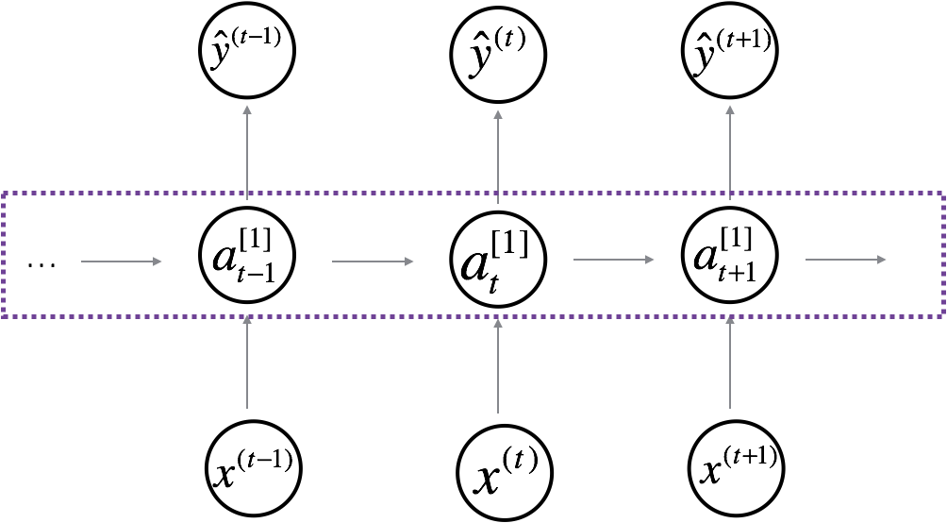
Neural Network examples
Standard NN
Convolutional NN
Recurrent NN

Slide 3

Introduction to Deep Learning
What is a
Neural Network?
deeplearning.ai

Slide 4
Housing Price Prediction
price
size of house

Slide 5
Housing Price Prediction

Slide 6
Deep Neural Networks
What does this
have to do with
the brain?

Slide 7
Forward and backward propagation
For example the first activation functions could be ReLU and the last one
Could be sigmoid
$$Z^{[1]}=W^{[1]}X+b^{[1]}$$
$${dZ}^{[L]}=A^{[L]}−Y$$
$$A^{[1]}=g^{\left[1\right]}(Z^{\left[1\right]})$$
$$dW^{[L]}=\frac{1}{m}dZ^{\left[L\right]}A^{{\left[L\right]}^{T}}$$
$$Z^{[2]}=W^{[2]}A^{[1]}+b^{[2]}$$
$$db^{[L]}=\frac{1}{m}np. sum(dZ^{\left[L\right]},axis=1, keepdims=True)$$
$$A^{[2]}=g^{\left[2\right]}(Z^{\left[2\right]})$$
…
$${dZ}^{[L−1]}=dW^{{\left[L\right]}^{T}}dZ^{\left[L\right]}{g^{′}}^{\left[L\right]}(Z^{\left[L−1\right]})$$
$$A^{[L]}=g^{\left[L\right]}\left(Z^{\left[L\right]}\right)=\hat{Y}$$
…
$${dZ}^{[1]}=dW^{{\left[L\right]}^{T}}dZ^{\left[2\right]}{g^{′}}^{\left[1\right]}(Z^{\left[1\right]})$$
$$dW^{[1]}=\frac{1}{m}dZ^{\left[1\right]}A^{{\left[1\right]}^{T}}$$
$$db^{[1]}=\frac{1}{m}np. sum(dZ^{\left[1\right]},axis=1, keepdims=True)$$
Align left/vertical will mess up the equations here

Slide 8
One hidden layer
Neural Network
Neural Network
Representation

Slide 9
Neural Network Representation
$$x_{1}$$
$$x_{2}$$
$$\hat{y}$$
$$x_{3}$$

Slide 10
One hidden layer
Neural Network
Computing a
Neural Network’s
Output

Slide 11
Neural Network Representation
$$x_{1}$$
$$x_{1}$$
$$x_{2}$$
$$σ(z)$$
$$a=\hat{y}$$
$$x_{2}$$
$$\hat{y}$$
$$w^{T}x+b$$
$$z$$
$$a$$
$$x_{3}$$
$$x_{3}$$
$$z=w^{T}x+b$$
$$a=σ(z)$$

Slide 12
Neural Network Representation
$$x_{1}$$
$$x_{1}$$
$$x_{2}$$
$$σ(z)$$
$$a=\hat{y}$$
$$x_{2}$$
$$\hat{y}$$
$$w^{T}x+b$$
$$z$$
$$a$$
$$x_{3}$$
$$x_{3}$$
$$z=w^{T}x+b$$
$$x_{1}$$
$$a=σ(z)$$
$$x_{2}$$
$$\hat{y}$$
$$x_{3}$$

Slide 13
Neural Network Representation
$$a_{1}^{\left[1\right]}$$
$z_{1}^{\left[1\right]}=w_{1}^{{\left[1\right]T}^{ }}x+b_{1}^{[1]}, a_{ 1}^{[1]}=σ(z_{1}^{\left[1\right]}$)
$$x_{1}$$
$$a_{2}^{\left[1\right]}$$
$z_{2}^{\left[1\right]}=w_{2}^{{\left[1\right]T}^{ }}x+b_{2}^{[1]}, a_{ 2}^{[1]}=σ(z_{2}^{\left[1\right]}$)
$$x_{2}$$
$$\hat{y}$$
$$a_{3}^{\left[1\right]}$$
$z_{3}^{\left[1\right]}=w_{3}^{{\left[1\right]T}^{ }}x+b_{3}^{[1]}, a_{ 3}^{[1]}=σ(z_{3}^{\left[1\right]}$)
$$x_{3}$$
$$a_{4}^{\left[1\right]}$$
$z_{4}^{\left[1\right]}=w_{4}^{{\left[1\right]T}^{ }}x+b_{4}^{[1]}, a_{ 4}^{[1]}=σ(z_{4}^{\left[1\right]}$)

Slide 14
Deep Neural Networks
Why deep
representations?

Slide 15
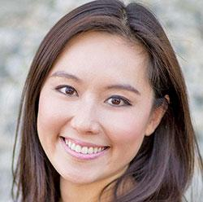
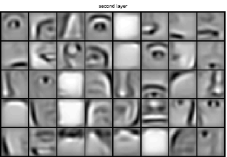
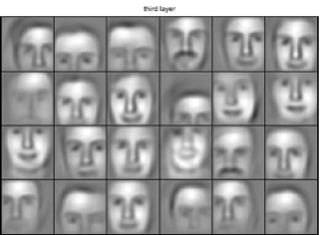
Intuition about deep representation
$$\hat{y}$$

Slide 16
Recurrent Neural Networks
Why sequence models?
deeplearning.ai

Slide 17
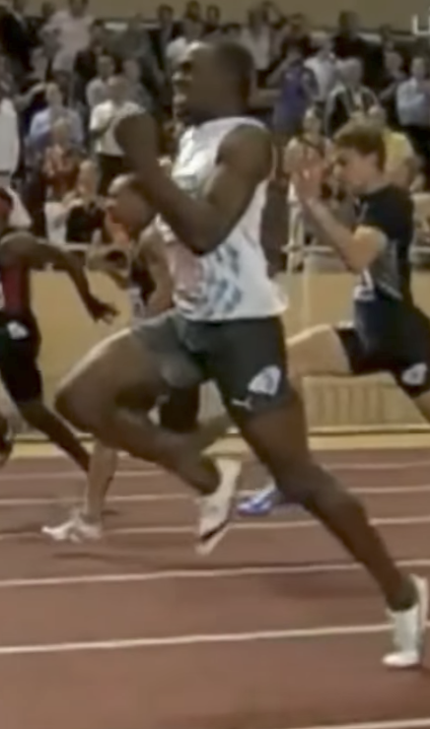
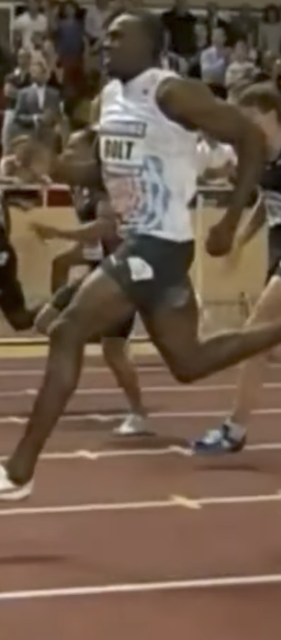
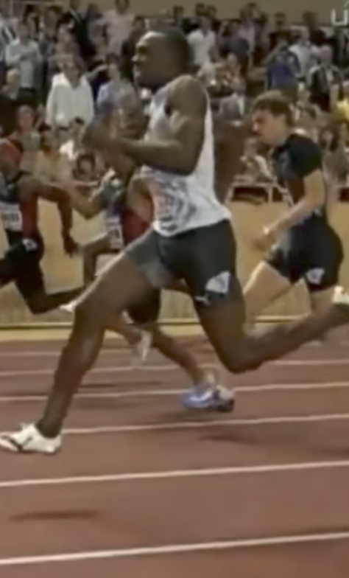
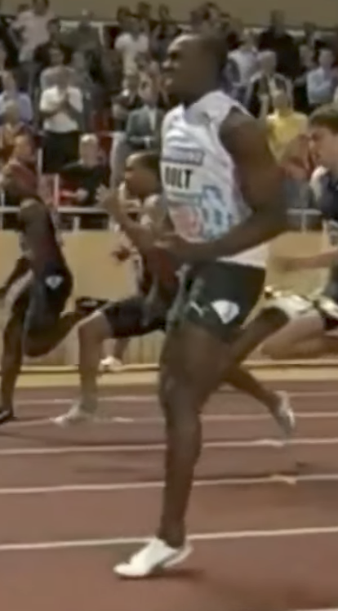
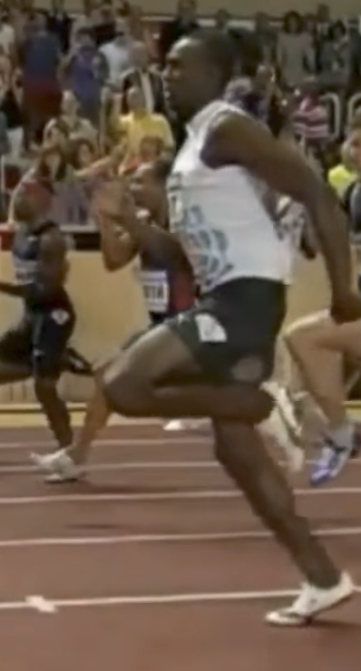
Examples of sequence data
“The quick brown fox jumped over the lazy dog.”
Speech recognition
Music generation
$$∅$$
Sentiment classification
“There is nothing to like in this movie.”
DNA sequence analysis
AGCCCCTGTGAGGAACTAG
AGCCCCTGTGAGGAACTAG
Machine translation
Voulez-vous chanter avec moi?
Do you want to sing with me?
Plasmid sequence AP4 Oligo
Video activity recognition
Running
Name entity recognition
Yesterday, Harry Potter met Hermione Granger.
Yesterday, Harry Potter met Hermione Granger.

Slide 18
Summary of RNN types
$${\hat{y}}^{<1>}$$
$${\hat{y}}^{<1>}$$
$${\hat{y}}^{<2>}$$
$${\hat{y}}^{<T_{y}>}$$
$${\hat{y}}^{ }$$
$$a^{<0>}$$
$$a^{<0>}$$
$$⋯$$
$$a^{<0>}$$
$$⋯$$
$$x^{<1>}$$
$$x$$
$$x^{<1>}$$
$$x^{<2>}$$
$$x^{<T_{x}>}$$
One to one
One to many
Many to one
$${\hat{y}}^{<1> }$$
$${\hat{y}}^{<2> }$$
$${{\hat{y}}^{<1>}}^{ }$$
$${{\hat{y}}^{<T_{y}>}}^{ }$$
$${\hat{y}}^{<T_{y}> }$$
$$a^{<0>}$$
$$⋯$$
$$⋯$$
$$⋯$$
$$a^{<0>}$$
$$⋯$$
$$x^{<1>}$$
$$x^{<T_{x}>}$$
$$x^{<1>}$$
$$x^{<2>}$$
$$x^{<T_{x}>}$$
Many to many
Many to many

Slide 19
Representing words
x:
Harry Potter and Hermione Granger invented a new spell.
$$x^{<1>}$$
$$x^{<2>}$$
$$x^{<3>}$$
$$⋯$$
$$x^{<9>}$$

Slide 20
Recurrent Neural Networks
Gated Recurrent Unit (GRU)
deeplearning.ai

Slide 21
RNN unit
$$a^{<t>}=g(W_{a}\left[a^{<t−1>}, x^{<t>}\right]+b_{a})$$
$${\hat{y}}^{<1> }$$
$$a^{<0>}$$
$$a^{<1>}$$
$$x^{<1>}$$

Slide 22
GRU (simplified)
The cat, which already ate …, was full.
[Cho et al., 2014. On the properties of neural machine translation: Encoder-decoder approaches]
[Chung et al., 2014. Empirical Evaluation of Gated Recurrent Neural Networks on Sequence Modeling]

Slide 23
Full GRU
$${\tilde{c}}^{<t>}=\tanh{(W_{c}[}$$
$$c^{<t−1>},x^{<t>}]+b_{c})$$
$$Γ_{u}=σ{(W_{u}\left[ c^{<t−1>},x^{<t>}\right]+b_{u})}$$
$$c^{<t>}=Γ_{u}{∗{\tilde{c}}^{<t>}+\left(1−Γ_{u}\right)+c^{<t−1>}}$$
The cat, which ate already, was full.

Slide 24
Recurrent Neural Networks
LSTM (long short term memory) unit
deeplearning.ai

Slide 25
GRU and LSTM
GRU
LSTM
$${\tilde{c}}^{<t>}=\tanh{(W_{c}\left[Γ_{r}∗c^{<t−1>},x^{<t>}\right]+b_{c})}$$
$$Γ_{u}=σ{(W_{u}\left[ c^{<t−1>},x^{<t>}\right]+b_{u})}$$
$$Γ_{r}=σ{(W_{r}\left[ c^{<t−1>},x^{<t>}\right]+b_{r})}$$
$$c^{<t>}=Γ_{u}{∗{\tilde{c}}^{<t>}+\left(1−Γ_{u}\right)∗c^{<t−1>}}$$
$$a^{<t>}=c^{<t>}$$
[Hochreiter & Schmidhuber 1997. Long short-term memory]

Slide 26
LSTM in pictures
$$y^{<t>}$$
$${\tilde{c}}^{<t>}=\tanh{(W_{c}\left[a^{<t−1>},x^{<t>}\right]+b_{c})}$$
softmax
$$a^{<t>}$$
$$Γ_{u}=σ{(W_{u}\left[ a^{<t−1>},x^{<t>}\right]+b_{u})}$$
-
-
$$c^{<t−1>}$$
$$c^{<t>}$$
-
*
$$⨁$$
-
$$Γ_{f}=σ{(W_{f}\left[ a^{<t−1>},x^{<t>}\right]+b_{f})}$$
$$c^{<t>}$$
*
tanh
$$Γ_{o}=σ{(W_{o}\left[ a^{<t−1>},x^{<t>}\right]+b_{o})}$$
$$a^{<t−1>}$$
*
$$a^{<t>}$$
$$f^{<t>}$$
$$i^{<t>}$$
$${\tilde{c}}^{<t>}$$
$$o^{<t>}$$
$$a^{<t>}$$
$$c^{<t>}={Γ_{u}∗{\tilde{c}}^{<t>}+Γ_{f}∗c^{<t−1>}}$$
forget gate
update gate
tanh
output gate
$$a^{<t>}=Γ_{o}∗c^{<t>}$$
$$x^{<t>}$$
$$y^{<1>}$$
$$y^{<2>}$$
$$y^{<3>}$$
softmax
softmax
softmax
$$a^{<1>}$$
$$a^{<2>}$$
-
$$c^{<2>}$$
$$a^{<3>}$$
-
-
$$c^{<1>}$$
-
-
$$c^{<3>}$$
-
-
-
-
-
-
$$c^{<0>}$$
*
$$⨁$$
-
$$c^{<1>}$$
*
$$⨁$$
$$c^{<2>}$$
*
$$⨁$$
$$a^{<0>}$$
$$a^{<1>}$$
$$a^{<2>}$$
$$a^{<2>}$$
$$a^{<1>}$$
$$a^{<3>}$$
$$x^{<1>}$$
$$x^{<2>}$$
$$x^{<3>}$$

Slide 27
Audio data
Trigger word detection
deeplearning.ai

Slide 28



What is trigger word detection?
Amazon Echo
(Alexa)
Baidu DuerOS
(xiaodunihao)
Apple Siri
(Hey Siri)
Google Home
(Okay Google)

Slide 29
Sequence to sequence models
Basic models
deeplearning.ai

Slide 30
Sequence to sequence model
$$x^{<1>}$$
$$x^{<2>}$$
$$x^{<3>}$$
$$x^{<4>}$$
$$x^{<5>}$$
Jane visite l’Afrique en septembre
Jane is visiting Africa in September.
$$y^{<1>}$$
$$y^{<2>}$$
$$y^{<3>}$$
$$y^{<4>}$$
$$y^{<5>}$$
$$y^{<6>}$$
$$a^{<0>}$$
$$⋯$$
$$x^{<1>}$$
$$x^{<T_{x}>}$$
[Sutskever et al., 2014. Sequence to sequence learning with neural networks]
[Cho et al., 2014. Learning phrase representations using RNN encoder-decoder for statistical machine translation]

Slide 31
Image captioning
$$y^{<1>}$$
$$y^{<2>}$$
$$y^{<3>}$$
$$y^{<4>}$$
$$y^{<5>}$$
$$y^{<6>}$$
A cat sitting on a chair
MAX-POOL
MAX-POOL
11$×$ 11
s = 4
3$×$ 3
s = 2
5$×$ 5
same
3$×$ 3
s = 2
3$×$ 3
same
3$×$ 3
55$×$55 $×9$6
27$×$27 $×$96
27$×$27 $×$256
13$×$13 $×$256
13$×$13 $×$384
MAX-POOL
=
3$×$ 3
3$×$ 3
s = 2
$$⋮$$
$$⋮$$
$$⋮$$
Softmax
1000
13$×$13 $×$384
13$×$13 $×$256
6$×$6 $×$256
9216
4096
4096
$${\hat{y}}^{<1>}$$
$${\hat{y}}^{<2>}$$
$${\hat{y}}^{<T_{y}>}$$
$$⋯$$
$$x$$
[Mao et. al., 2014. Deep captioning with multimodal recurrent neural networks]
[Vinyals et. al., 2014. Show and tell: Neural image caption generator]
[Karpathy and Li, 2015. Deep visual-semantic alignments for generating image descriptions]

Slide 32
Sequence to sequence models
Attention model intuition
deeplearning.ai

Slide 33
The problem of long sequences
$${{\hat{y}}^{<1>}}^{ }$$
$${{\hat{y}}^{<T_{y}>}}^{ }$$
$$a^{<0>}$$
$$⋯$$
$$⋯$$
$$x^{<1>}$$
$$x^{<T_{x}>}$$
Jane s'est rendue en Afrique en septembre dernier, a apprécié la culture et a rencontré beaucoup de gens merveilleux; elle est revenue en parlant comment son voyage était merveilleux, et elle me tente d'y aller aussi.
Jane went to Africa last September, and enjoyed the culture and met many wonderful people; she came back raving about how wonderful her trip was, and is tempting me to go too.
Bleu
score
10
20
30
40
50
Sentence length

Slide 34
Attention model intuition
$${\hat{y}}^{<1> }$$
$${\hat{y}}^{<2> }$$
$${\hat{y}}^{<3> }$$
$${\hat{y}}^{<4> }$$
$${\hat{y}}^{<5> }$$
$$a^{<0>}$$
$$x^{<1>}$$
$$x^{<2>}$$
$$x^{<3>}$$
$$x^{<4>}$$
$$x^{<5>}$$
jane
visite
l’Afrique
en
septembre
[Bahdanau et. al., 2014. Neural machine translation by jointly learning to align and translate]

Slide 35
Sequence to sequence models
Attention model
deeplearning.ai

Slide 36
Attention model
$$a^{<0>}$$
$$x^{<1>}$$
$$x^{<2>}$$
$$x^{<3>}$$
$$x^{<4>}$$
$$x^{<5>}$$
jane
visite
l’Afrique
en
septembre
[Bahdanau et. al., 2014. Neural machine translation by jointly learning to align and translate]

Slide 37
Computing attention $α^{<t,t^{′}>}$
$α^{<t,t^{′}>}$ = amount of attention $y^{<t >}$ should pay to $a^{<t^{′}>}$
$${\hat{y}}^{<t−1>}$$
$${\hat{y}}^{<t>}$$
$α^{<t,t^{′}>}$ = $\frac{exp⁡(e^{<t,t^{′}>})}{∑_{t^{′}=1}^{T_{x}}exp⁡(e^{<t,t^{′}>}) }$
$$s^{<t−1>}$$
$$s^{<t>}$$
$$+$$
$$s^{<t−1>}$$
$$e^{<t,t^{′}>}$$
$$a^{<t^{′}>}$$
$$a^{<0>}$$
$$⋯$$
$$x^{<1>}$$
$$x^{<2>}$$
$$x^{<T_{x}−1>}$$
$$x^{<T_{x}>}$$
[Bahdanau et. al., 2014. Neural machine translation by jointly learning to align and translate]
[Xu et. al., 2015. Show, attend and tell: Neural image caption generation with visual attention]

Slide 38
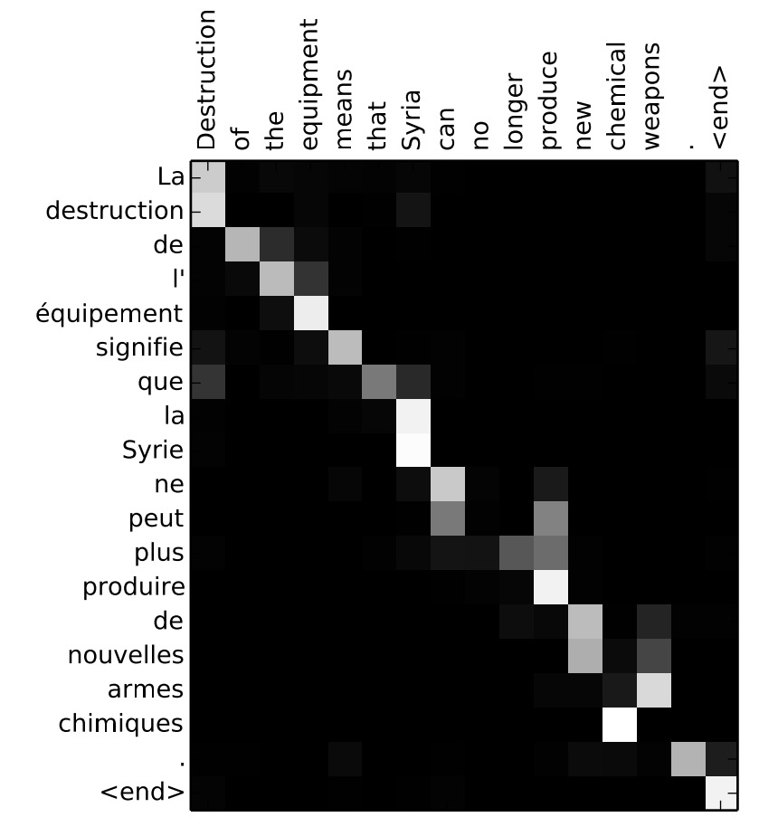
Attention examples
July 20th 1969
$1969−07−20$
${23}^{ }$April, $1564$
$1564−04−23$
Visualization of $α^{<t,t^{′}>}$:

